Slide 1
Computational Materials Review
Guilherme Ryuji Weber Nakamura

Slide 2
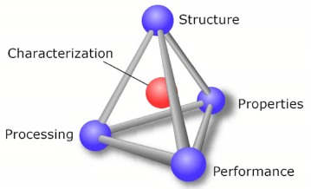
Paradigm

Slide 3
Simulations vs Informatics

Slide 4
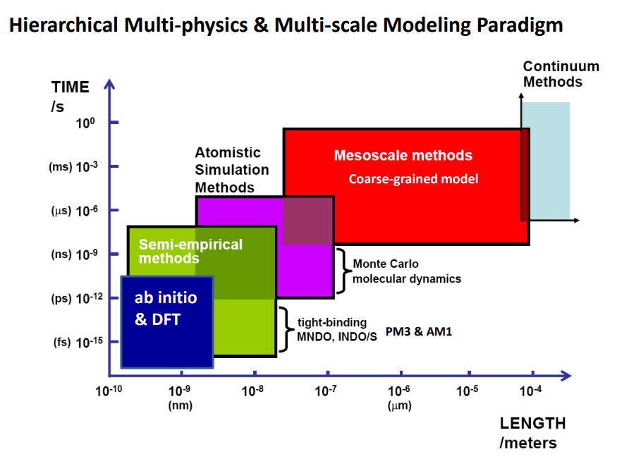

Slide 5
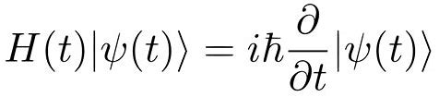
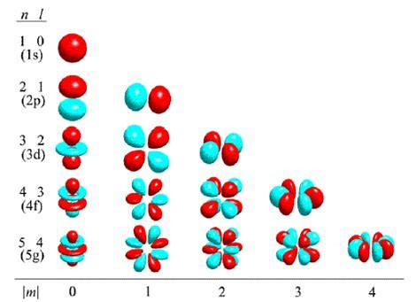
Ab Initio and Quantum Mechanics
Schrödinger Equation
Multi-body system
> O(n²)
Approximations and Constraints
Born-Oppenheimer
Hartree-Fock
ENERGY
Second Quantization
Perturbation Theory
Relativistic vs Non-Relativistic

Slide 6
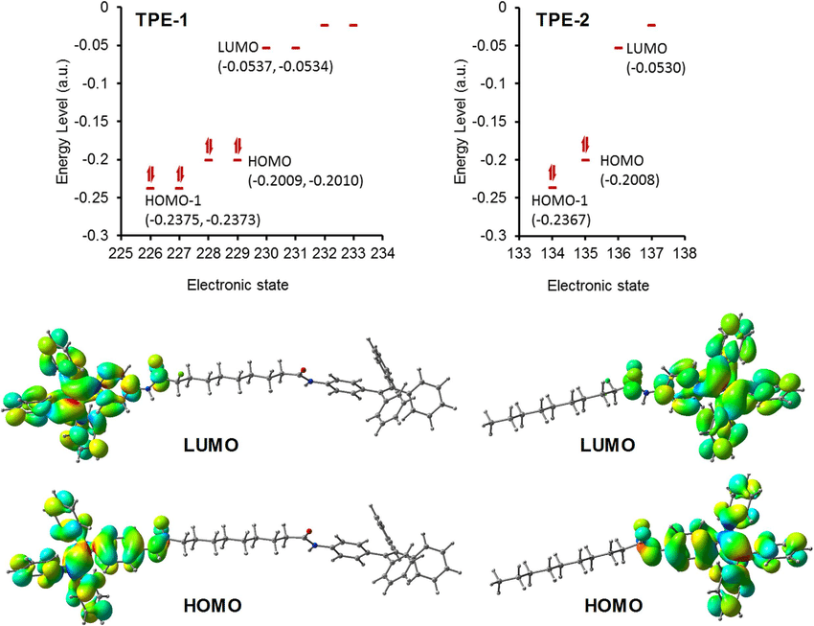
Density-Functional Theory (DFT)
Function, Functional and Functor
Hohehnberg – Kohn
Unique v(r) = F(n(r))
E is min for n(r) exact
Kohn – Sham Equations
Ground State
Materials Project, CMR, OQMD…
ORCA, Gaussian, Jaguar…

Slide 7
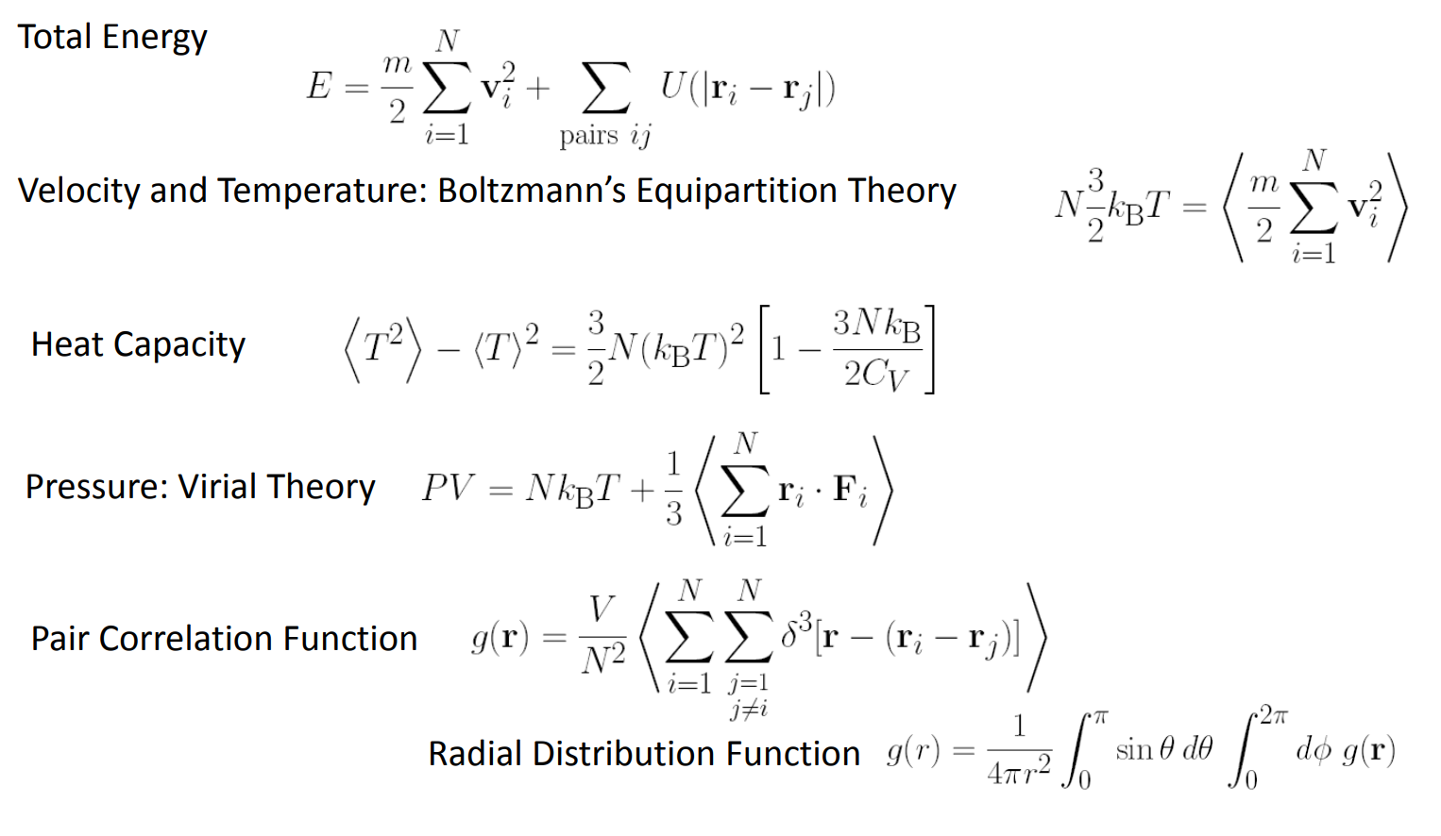
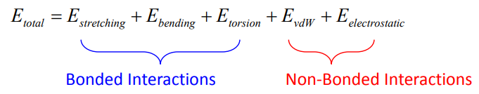
Molecular Dynamics
Statistical Mechanics
Microstates of equal energy are equally likely
Time average is equivalent to ensemble average
NVE, NVT, NPT, μVT
Bead and Spring, Classical
Force Fields
Morse
Lennard-Jones

Slide 8
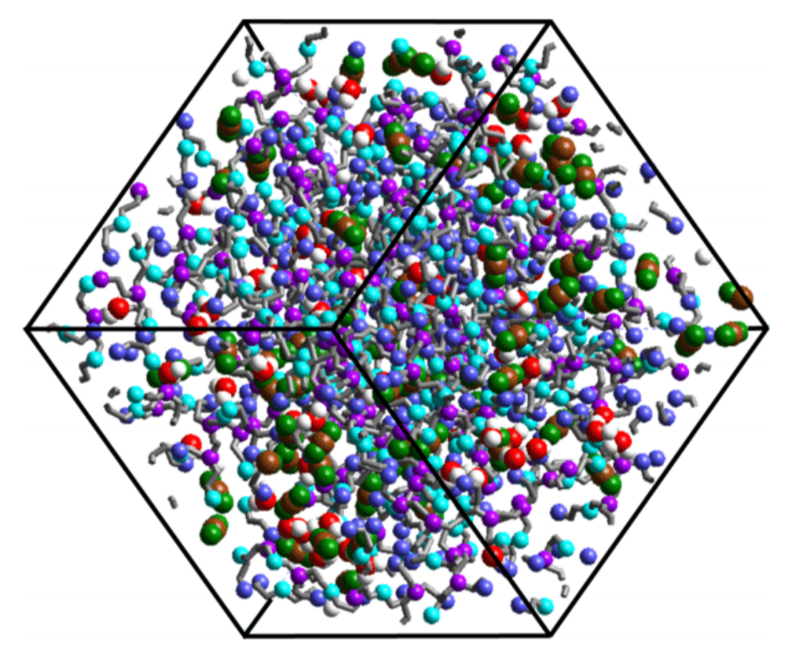
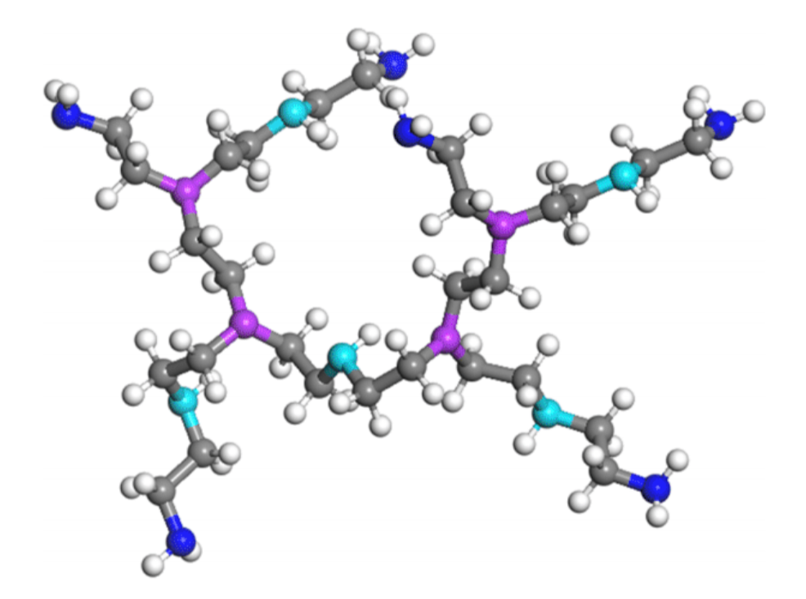
No Electrons
Tricks
Geometric Optimizations
LAMMPS…

Slide 9
Monte Carlo
Randomness
Brute force statistics
Coupled degrees of freedom
Fluids, disordered materials, strongly coupled solids, and cellular structures
No time evolution

Slide 10
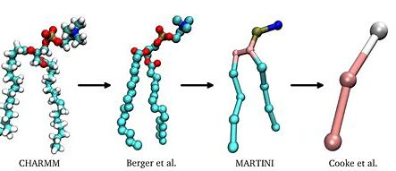
Mesoscale - Corse Grained
Pseudo-atoms
Less degrees of freedom => Longer simulation times
Each model for specific types of simulations
Biological systems

Slide 11
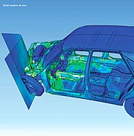
Continuum - Finite Elements
Continuum Hypothesis (Physics)
Discretization
Variational Calculus
Solving partial numerical equation numerically
Boundary Value Problems
Commercial Software
Ansys, Simulink, Solid Works

Slide 12
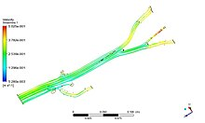
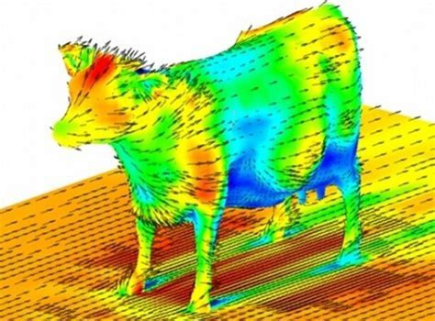
Other Simulations
Computational Fluid Dynamics
Navier-Stokes Numerically
Semi-Empirical Models
Tight Binding
MNDO
INDOIS
PM3&AM1
(Extended) Discrete Element Analysis
(Multi Scale) Green Functions
Etc…

Slide 13
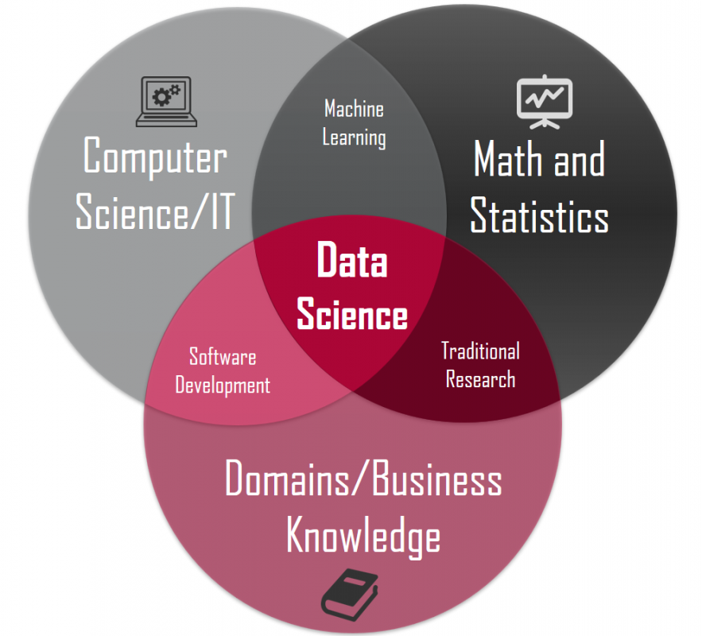
Materials Informatics
Data Science
Understanding, Use, Selection, Development, and Discovery
Big Data
Efficiency

Slide 14
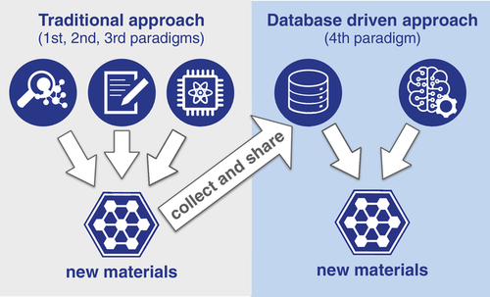

Slide 15
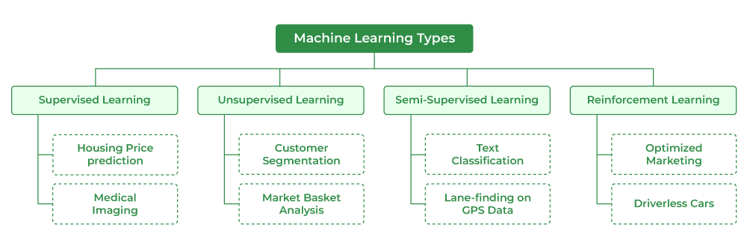
Machine Learning
Supervised, Unsupervised and Reinforcement
Tool. GIGO.
Ask the right questions.

Slide 16
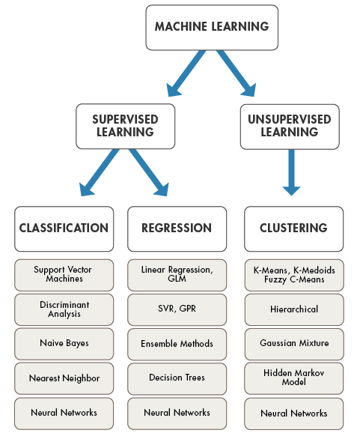

Slide 17
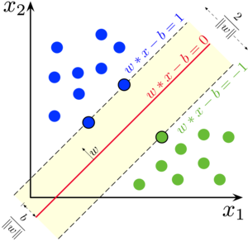
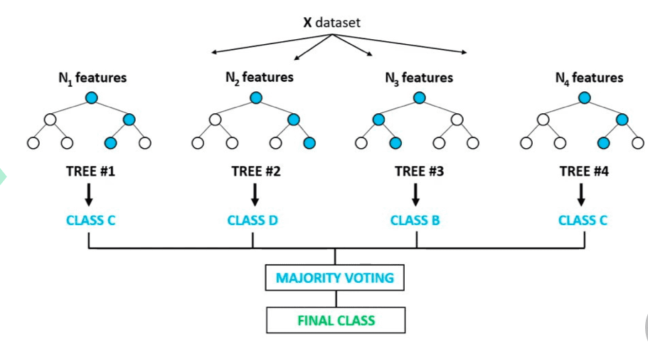
Detailed Models
Regression
Linear
Polynomial
Ridge/Lasso
Support Vector Regression (SVR)
Classification
Logistic Regression
Naïve Bayes
K Nearest Neighbor (KNN)
Support Vector Machines (SVM)
Decision Trees
Random Forest
K-Means Clustering

Slide 18
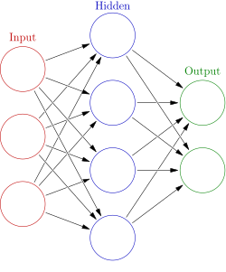
Deep Learning and Neural Networks
Networks of mathematical equations.
Autoencoders
Boltzmann Machine
Convolution Neural Networks
Multi-layer perceptron
Recurrent Neural Networks
Dimensionality Reduction
Much more…

Slide 19
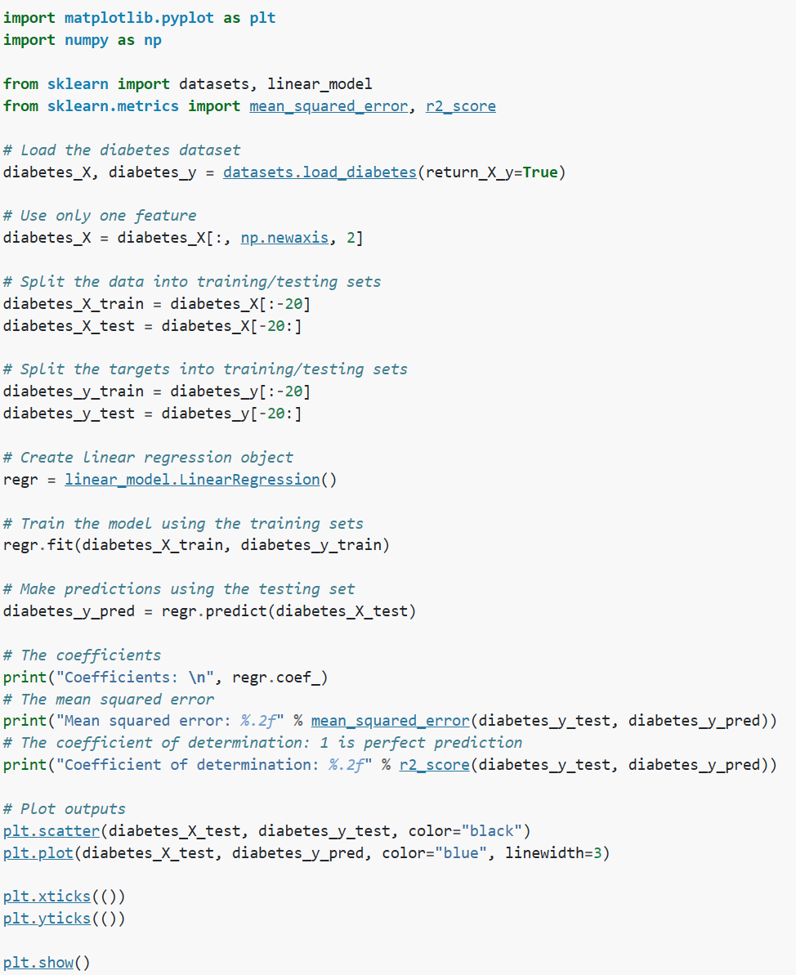
Hands-on
Features and Labels
#C, E => Tf
Parameters
Lambda, alpha, poly, …
Metrics
MAE, MSE, and RMSE
Accuracy, Precision, Recall and F1
Python
Scikit-learn
Keras
PyTorch
TensorFLow
MATLAB
ML and Deep Learning Toolboxes

Slide 20
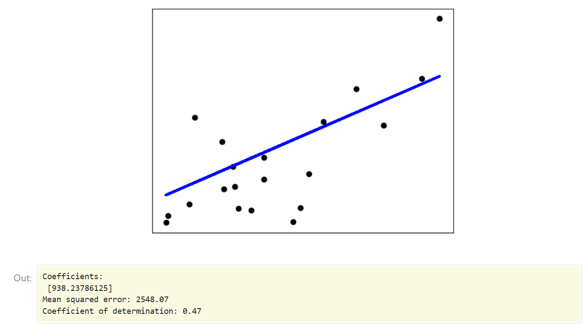

Slide 21
Georgia Tech examples
Polymerize
CO₂ capture membranes
Fuel cell technology
Semiconducting Polymers
Protein Unfolding
Structural Analysis

Slide 22
Possible ideas for next semesters…

Slide 23
Introduction to Scikit-Learn (sklearn) in Python • datagy
An introduction to machine learning with scikit-learn — scikit-learn 1.3.2 documentation
1.17. Neural network models (supervised) — scikit-learn 1.3.2 documentation
8 Machine Learning Models Explained in 20 Minutes | DataCamp

